Slide 1



Personal Bank Ledger and Statement Generator
PROJECT PRESENTATION
BACHUPALLY CAMPUS
A Java-based application to record transactions, track balances and generate bank statements
GUIDED BY
Pavithra Mam
Personal Bank Ledger and Statement Generator using JAVA programming
TEAM NO : 10
R. Sai Kumar
Roll No : 2620090005
S. Narasimha Reddy
Roll No : 2620040086

Slide 2



Abstract
OVERVIEW
The Personal Bank Ledger and Statement Generator is a Java-based application designed to maintain and generate a simple personal banking record. The system allows users to enter account details, opening balance, and multiple financial transactions. For each transaction, the user can specify the date,description, payment type, transaction type, and amount. The program automatically calculates the updated account balance, total deposits, and total withdrawals while preventing withdrawals that exceed the available balance. Finally, it generates a formatted bank statement displaying all transaction details and the closing balance.
On developing this program, it helps the user to avoid paper work, it saves lot of time for user, it minimizes wrong entries. It also provides an organized and reliable method for maintaining records and generating useful reports.
Avoids paperwork
Digital records replace manual ledgers
Saves time
Balances and totals calculated instantly
Minimizes wrong entries
Validation keeps records accurate and reliable

Slide 3


Understanding the Problem
PROBLEM STATEMENT
The Problem
Our Solution
Manually recording deposits and withdrawals is time-consuming
Calculating the remaining balance by hand leads to errors
Tracking transaction details and preparing statements is tedious
Centralized, organized management of personal transactions
Balance updates automatically after each successful transaction
Prevents withdrawals beyond the available balance
Unique transaction IDs and a complete history
Totals deposits and withdrawals; generates a formatted statement
→

Slide 4





What the System Does
FEATURES
Deposit & Withdraw
Overdraft Protection
Unique Transaction IDs
Record every transaction with description, payment method and amount
Withdrawals above the available balance are rejected
Every entry gets its own ID, starting from 101
Search by ID
Ledger Statistics
Saved Statement
Find any transaction instantly using its unique ID
Totals of deposits, withdrawals, counts and amounts by description
A formatted statement is saved as a text file for future reference

Slide 5
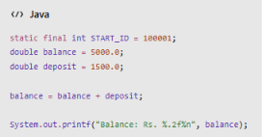
CO 1 · Fundamentals & I/O
COURSE OUTCOME 1 OF 6
Primitive data types: int, double, boolean
Variables and constants: variables, static final
Identifiers and literals
Operators: arithmetic, relational, logical, assignment
Expression evaluation and operator precedence
Console input using Scanner
Formatted output using System.out.printf()
Problem-solving and program structure
Used in this project
Notes:
Good morning, everyone.
CO1 explains the basic concepts of Java used in our project. We use data types like int to store transaction IDs and double to store transaction amounts. We use variables to maintain the account balance, operators to calculate deposits and withdrawals, and Scanner to accept user input. We use System.out.printf() to display the output neatly.
These concepts help us build the basic structure of our banking application.

Slide 6
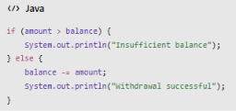
CO 2 · Control Flow & Menus
COURSE OUTCOME 2 OF 6
Conditional statements: if, if-else
switch statement with case, break, default
do-while loop
while loop
Enhanced for loop
Input validation using conditions
Menu-driven programming
Used in this project
Notes:
if-else: Checks sufficient balance before withdrawal.
switch-case: Selects operations from the menu.
Loops (while, do-while): Repeat the menu and validate user input.
Enhanced for loop: Displays transaction history.
Input validation: Rejects invalid amounts and menu choices.

Slide 7
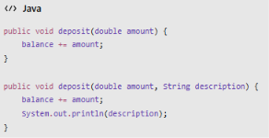
CO 3 · Methods & Recursion
COURSE OUTCOME 3 OF 6
Modular programming using methods
Parameter passing and return values
Method overloading: deposit()
Recursion: transaction searching
Searching for a transaction by ID
Traversal of transaction records
Used in this project
Notes:
In our project, methods help us perform separate tasks, such as depositing money, withdrawing money, and searching for transactions. Method overloading allows us to use the same method name with different parameters. Recursion means a method calls itself, and our project uses recursion for transaction searching.
These concepts make our program more organized and easier to maintain.

Slide 8
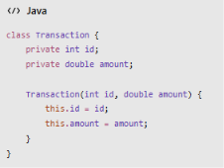
CO 4 · Object-Oriented Programming
COURSE OUTCOME 4 OF 6
Classes and objects
Object creation using new
Parameterized constructors
Encapsulation using private fields
Accessor methods (getters)
Instance variables
Constants using static final
this reference
toString() method
Interface and method overriding: toString(), compareTo()
Exception handling using try-catch
NumberFormatException, IOException
Used in this project
Notes:
Classes and objects: BankAccount and Transaction organize account data.
Constructors: Initialize account and transaction objects.
Encapsulation: Private fields protect data.
Inheritance of behavior through interfaces: BankAccount implements Reportable.
Method overriding: Implements toString(), compareTo(), and generateStatement().
Exception handling: Handles invalid input and file errors.

Slide 9
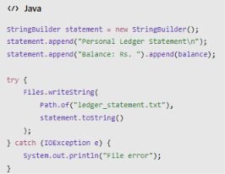
CO 5 · Strings & File Handling
COURSE OUTCOME 5 OF 6
String creation and manipulation
trim(), isEmpty() and append()
Mutable strings using StringBuilder
Sorting using Collections.sort()
Comparator using Comparator.comparingDouble()
compareTo()
File paths using Path.of()
File options: CREATE, WRITE, READ, DELETE
Exception handling during file operations
Used in this project
Notes:
String methods: trim() and isEmpty() validate text input.
StringBuilder: Builds the formatted statement.
Comparable and Comparator: Sort transactions by ID or amount.
Collections.sort(): Sorts transaction records.
File handling: Files.writeString() saves the statement to ledger_statement.txt.
Date and time: LocalDateTime records transaction timestamps.

Slide 10
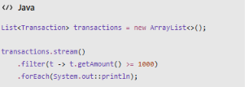
CO 6 · Collections & Streams
COURSE OUTCOME 6 OF 6
List and ArrayList
Set and HashSet
Map and HashMap; ordered map using TreeMap
Enhanced for loop and collection iteration
Lambda expressions
Method references, such as System.out::println
Functional interface: Predicate
Stream operations: filter(), mapToDouble(), sorted(), count(), sum(), forEach()
Comparator for sorting transactions
Map operations using merge()
Used in this project
Notes:
CO6 focuses on collections and streams in Java.
In our project, ArrayList is used to maintain transaction records. HashSet can store unique values, while HashMap and TreeMap help organize data using keys. Streams help us filter transactions, sort records, count transactions, and calculate the total deposit or withdrawal amount.
These concepts help us manage transaction data efficiently and generate useful bank statements.

Slide 11


Conclusion
WRAP-UP
Record & Track
Automatic & Safe
Report-Ready
Maintains deposits and withdrawals with dates, payment methods and unique IDs from 101, with search by transaction ID.
Updates the balance after every successful transaction and blocks withdrawals when funds are insufficient.
Calculates totals, organizes records and generates a formatted statement saved as a text file.
A computerized ledger reduces manual calculation, improves record organization and makes personal financial tracking convenient and reliable — a practical demonstration of Java programming concepts.

Slide 12
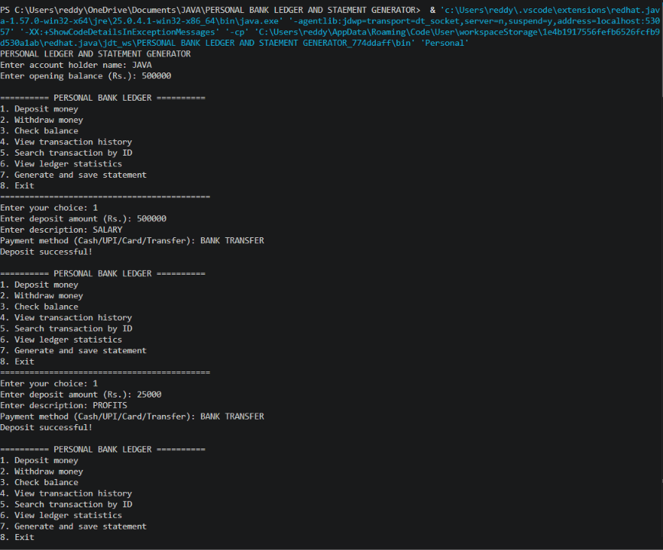
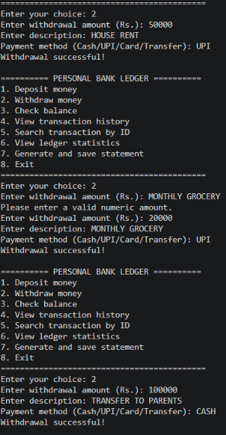
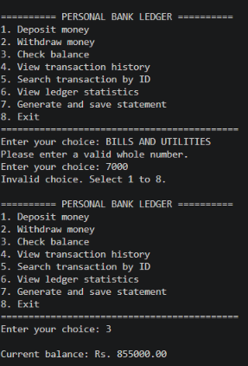
Output: Deposits, Withdrawals & Validation
SCREENSHOTS 1 OF 3
Deposits through the menu
Withdrawals with validation
Invalid input handled · balance check

Slide 13
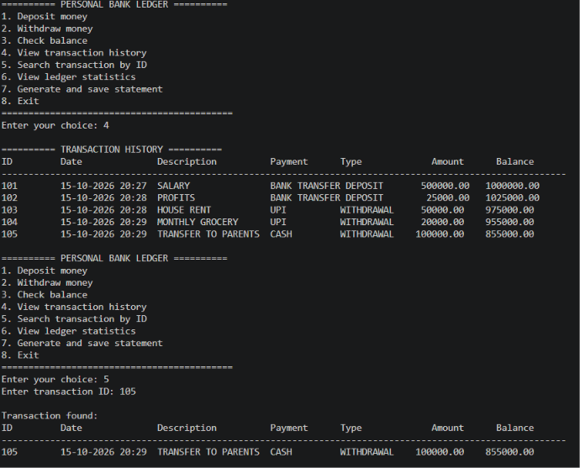
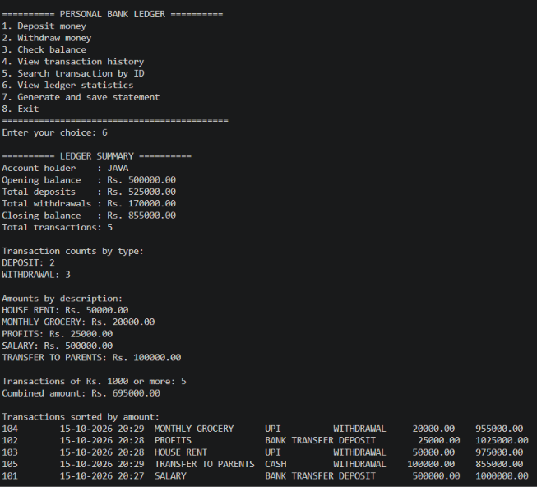
Output: History, Search & Summary
SCREENSHOTS 2 OF 3
Transaction history & search by ID
Ledger summary & statistics

Slide 14
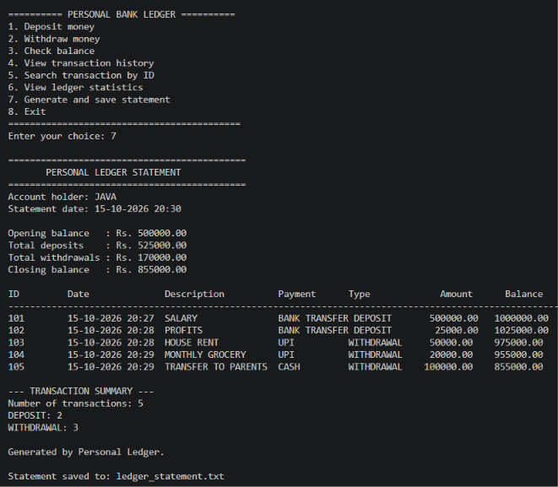
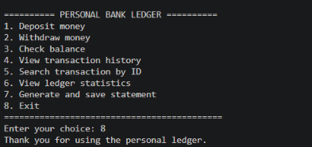
Generated File: ledger_statement.txt
SCREENSHOTS 3 OF 3
Statement saved to disk
Account holder and statement date
Opening, deposit, withdrawal and closing totals
Full transaction table with IDs and balances
Transaction summary by type
Clean exit from the menu

Slide 15
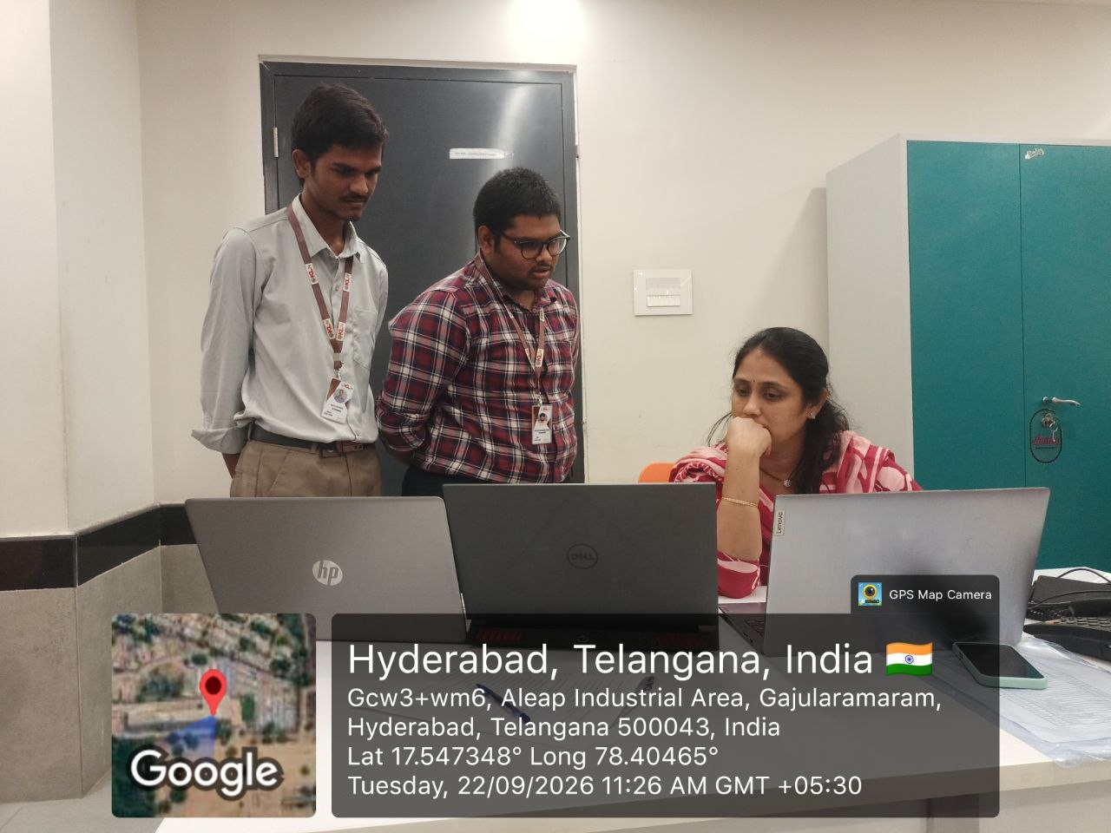

Team & Source Code
THANK YOU
PROJECT REPOSITORY
https://github.com/reddy68n/PERSONAL-BANKING-LEDGER-STATEMENT-GENERATOR.git
NARASIMHA REDDY
https://github.com/reddy68n
SAI KUMAR
https://github.com/ratala-saikumar
Geo-tagged team photo · Hyderabad, Telangana
R. Sai Kumar (2620090005) · Narasimha Reddy (2620040086) · Team 10

